Slide 1
EMPLOYEE DATA ANALYSIS USING EXCEL
Student name: F. ABDUL RASAK
Register number:312206398
Department: COMMERCE
College: AGARCHAND MANMULL JAIN COLLEGE

Slide 2
PROJECT TITLED:
EMPLOYEE PERFORMANCE ANALYSIS USING EXCEL

Slide 3
AGENDA:
Problem solving
Project overview
End users
Our solution and proposition
Dataset Description
Results and discussion
Conclusion

Slide 4
PROBLEM STATEMENT :
This analysis is created to track the performance of the employee in order to provide promotion incentive to the respective employees
This analysis helps the organisation to grow by the growth of the employee of the organisation

Slide 5
PROJECT OVERVIEW:
Employee performance analysis is created to analyse all the data like attendance,gender,age,high, medium,low,very high skilled employees of the organisation

Slide 6

WHO ARE THE END USERS?
Employees
Managers
Employers
Managerial organisations
Industrial organizations

Slide 7
OUR SOLUTION AND ITS VALUE PROPOSITION :
Condition formatting – Missing
Pivot table – summary
Charts – Trends
Filtering and formula – performance
Graph – data visualization

Slide 8
DATASET DESCRIPTION:
Employee=kaggle
26- Features
9- Features
Employee id- numerical values
Name- text
Employee type
Performance level
Employee rating- numerical values

Slide 9
THE “WOW” IN OUR SOLUTION
Performance level =IFS(Z8>=5,”VERY HIGH”,Z8>=4,”HIGH”,Z8>=3,”MED,TRUE,”LOW”)

Slide 10

MODELLING
Data collection
Download from edunet dashboard
Data cleaning
Identified the missing values
Filter out missing values
Performance level
Created a formula
Summary
Pivot table
Graph

Slide 11
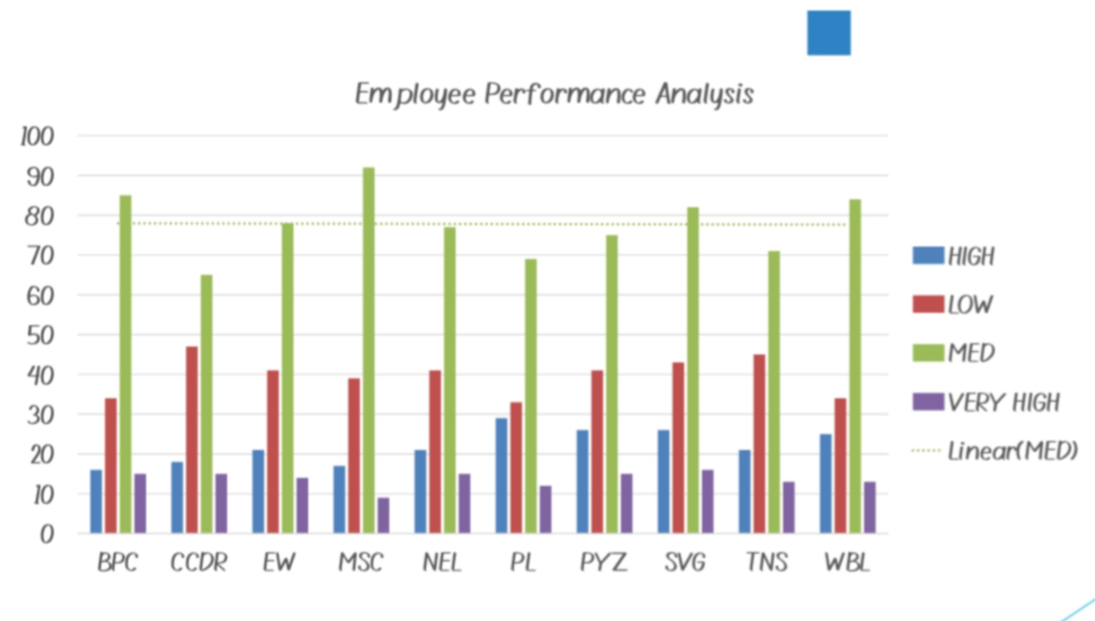
RESULT:

Slide 12
CONCLUSION:
After comparing the result, we can see that the number of employees are highly performed in PL SECTOR of the organisation
To improve the standard of the organisation, we must motivate the employees of the other sectors by giving various tasks based on their strength and skills.

